Slide 1
Rotary Club of Space Center August 6, 1964 – August 6, 2014 Presidents and District Governors

Slide 2
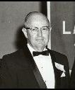
Ivan. E. Brown President 1964-65

Slide 3
Ivan. E. Brown President 1965-66

Slide 4
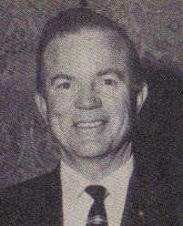
Martin Gracey President 1966-67

Slide 5
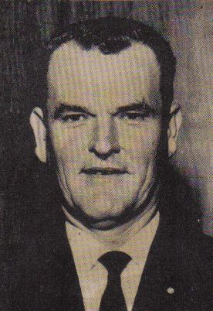
Richard Allen President 1967-68

Slide 6
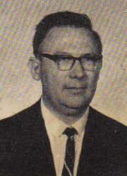
Jerome "Jerry" B. Hammack President 1968-69

Slide 7
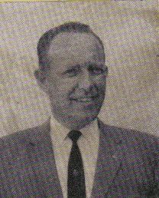
Roger F. Hobart President 1969-70

Slide 8
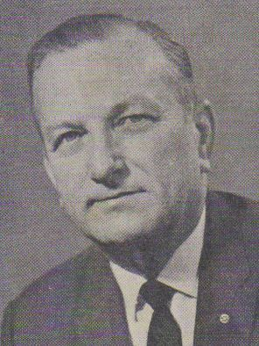
Orville G. "Gene" Lindquist President 1970-71

Slide 9
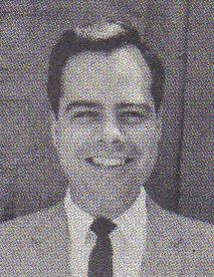
Robert "Bob" K. Scott President 1971-72

Slide 10
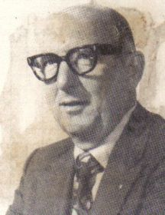
Frank Morgan President 1972-73

Slide 11
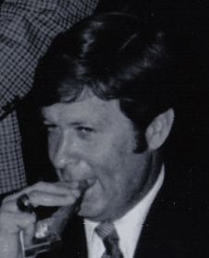
Rex Bailey President 1973-74

Slide 12
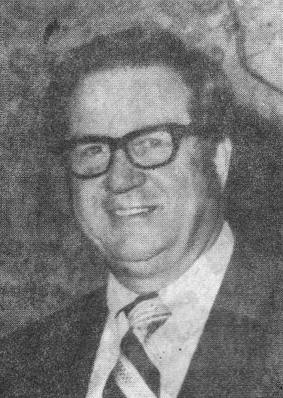
Richard Chandler President 1974-75

Slide 13
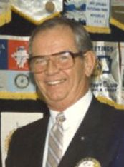
Donald Kirk President 1975-76

Slide 14
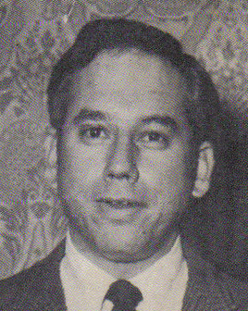
Dr. Lionel Gonzalo Garcia President 1976-77

Slide 15
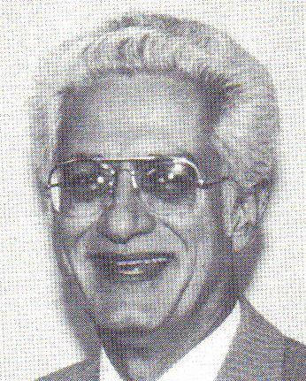
James "Jim" Lloyd Wyatt President 1977-78

Slide 16
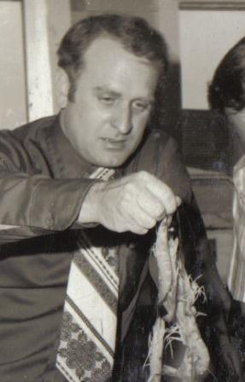
Marvin Matthews President 1978-79

Slide 17
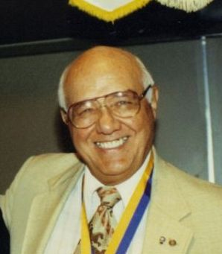
Kenneth A. Ligrani President 1979-80

Slide 18
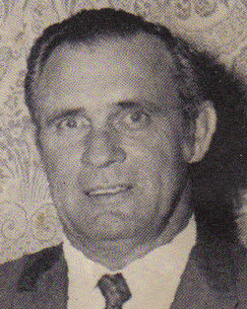
Chester E. "Pete“ Gist President 1980-81

Slide 19
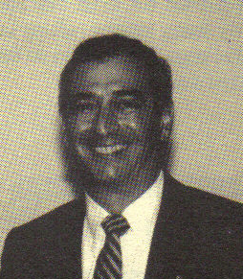
Mansour A. Jowid President 1981-82

Slide 20
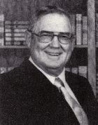
Dr. Floyd D. Boze Elected District 589 Governor 1981-82

Slide 21
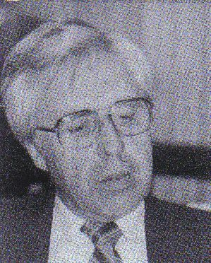
Charles "Chuck" A. Jacobson President 1982-83

Slide 22
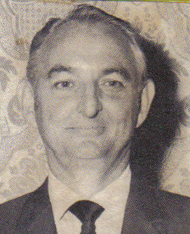
William "Bill" Joseph Webb President 1983-84

Slide 23
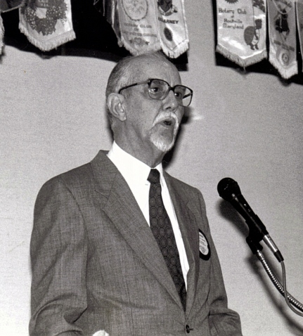
Charles Henry Hartman President 1984-85

Slide 24
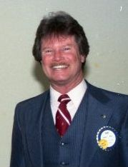
Robert James Wren President 1985-86

Slide 25
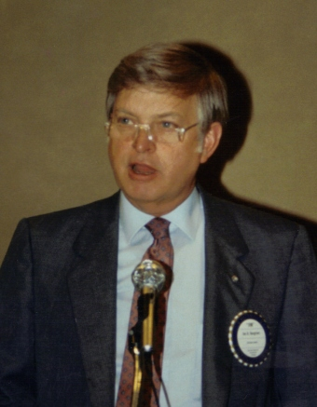
Jim Hargrove President 1986-87

Slide 26
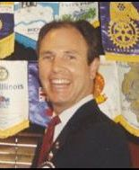
Jim McNatt President 1987-88

Slide 27
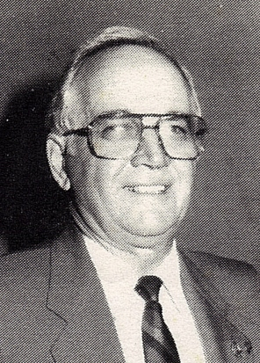
Billy D. Weseman President 1988-89

Slide 28
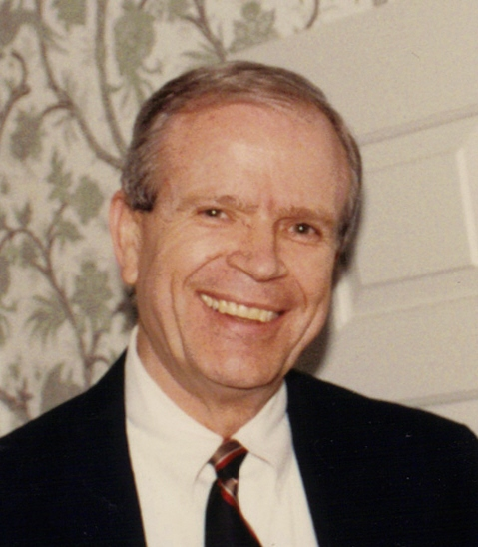
John Watson President 1989-90

Slide 29
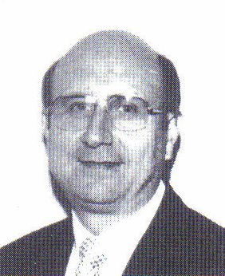
Billy R. Smith President 1990-91

Slide 30
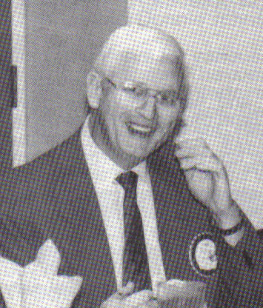
Jack R. Lister President 1991-92

Slide 31
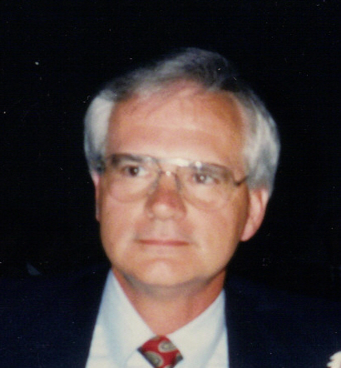
Terry W. Hesson President 1992-93

Slide 32
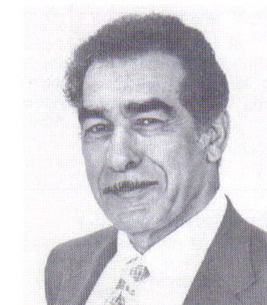
Victor G. Maria President 1993-94

Slide 33
Billy D. Weseman Elected District 5890 Governor 1993-94

Slide 34
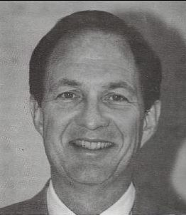
Dr. David T. Taylor President 1994-95

Slide 35
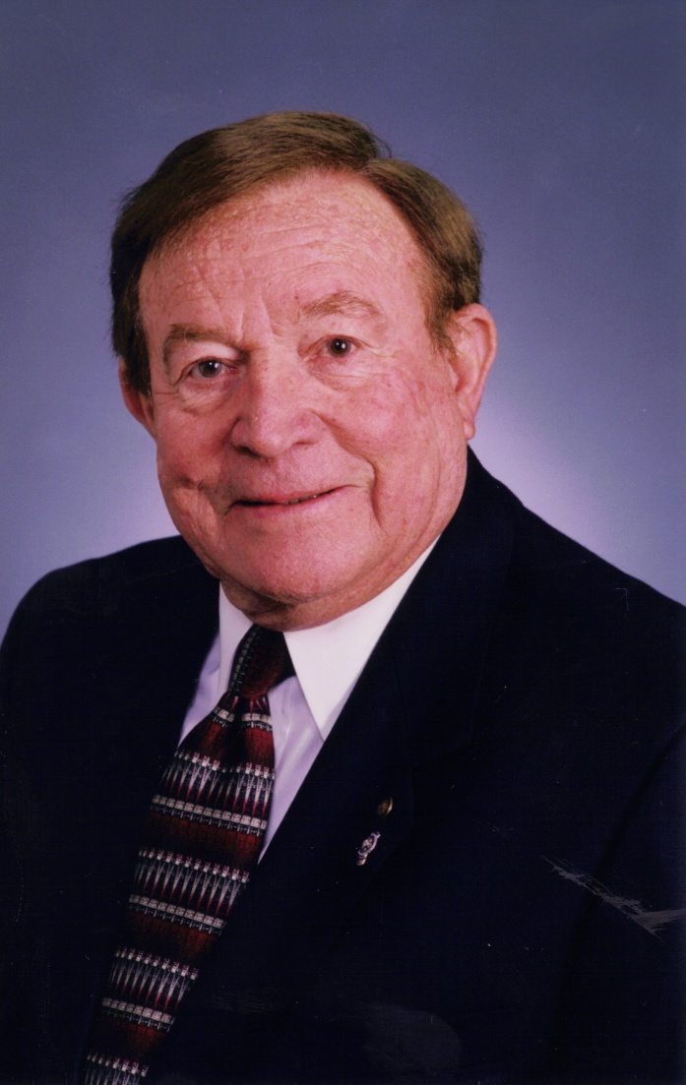
Lamar D. Bowles President 1995-96

Slide 36
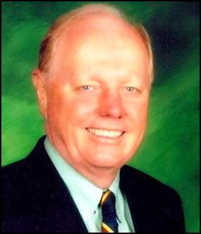
John W. Lowes, III President 1996-97

Slide 37
Donnie P. Johnson President 1997-98

Slide 38
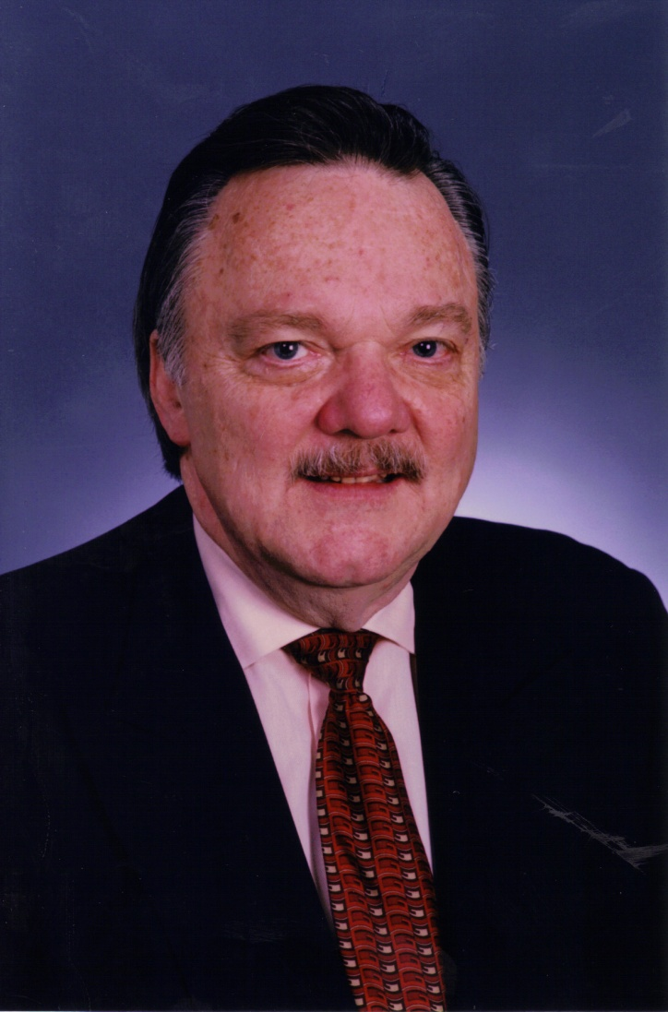
Dick H. Gregg, Jr President 1998-99

Slide 39
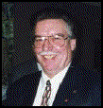
David Baldwin President 2000-01

Slide 40
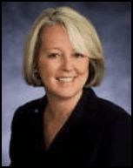
Susan "Suzi" Howe President 2001-02

Slide 41
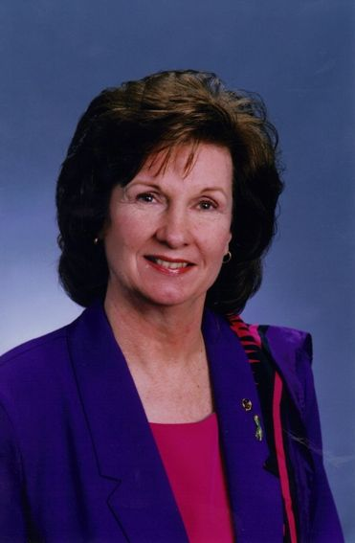
Laura Hale President 2002-03

Slide 42
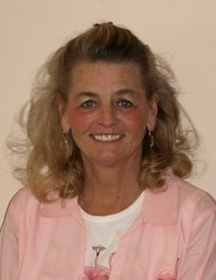
Shelia Self President 2003-04

Slide 43
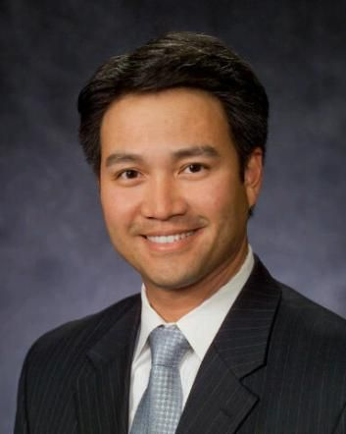
Dr. Vissett Sun President 2004-05

Slide 44
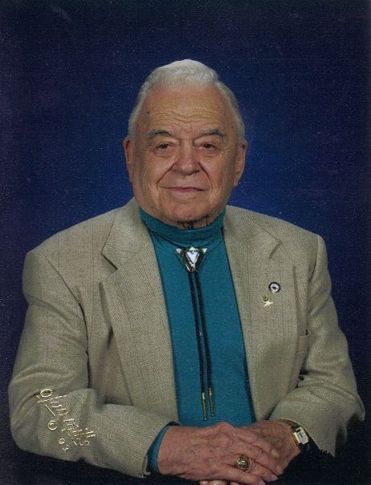
J. B. Fox President 2005-06

Slide 45
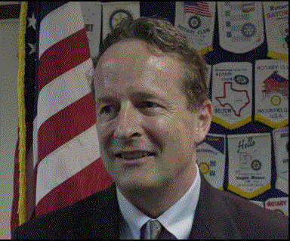
Geoffrey Atwater President 2006-07

Slide 46
Suzi C. Howe Elected District 5890 Governor 2006-07

Slide 47
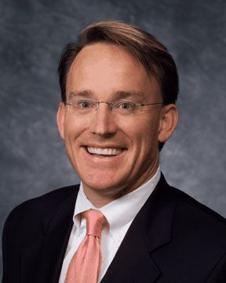
Dick Gregg III President 2007-08

Slide 48
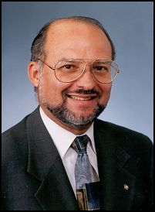
Mike A. Hernandez President 2008-09

Slide 49
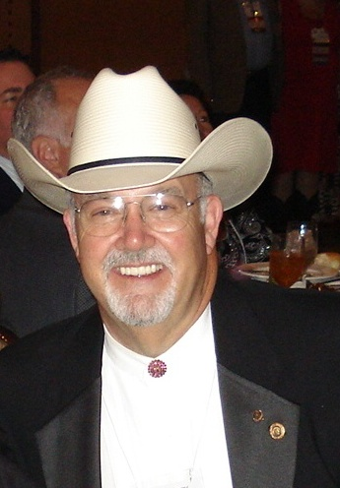
Jon McKinnie President 2009-10

Slide 50
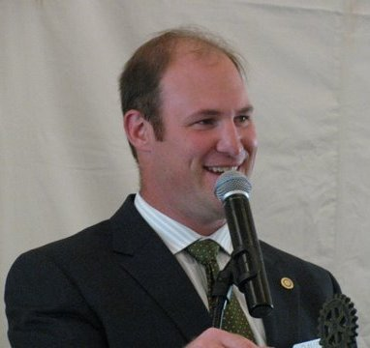
David B. Coney President 2010-11

Slide 51
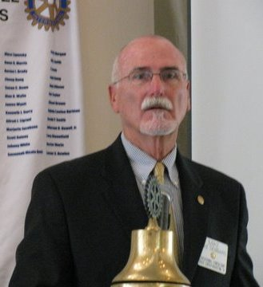
Michael D. Dennard President 2011-12

Slide 52
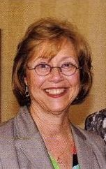
Marilyn Musial President 2012-13

Slide 53
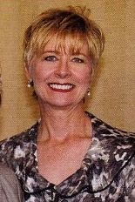
Sheryl Berg President 2013-14

